Slide 1

Capability Information
ElectroData LLC
(Environmental, Technical & Software Solution Consultants)
Denver, Colorado

Slide 2
Mission
ElectroData
Discriminators
Excellence
Stability
Diversity
Cost/Schedule
Industry Experience
"At ElectroData and Partner companies , our engineers, programmers and technicians have an ongoing commitment to innovative technology and uncompromising quality. ElectroData LLC along with partner companies continues to provide turn-key solutions which are leading the way in setting new standards of excellence in City, Financials, Health Care and other commercial organizations."

Slide 3
Industry Experience
ElectroData
Discriminators
Excellence
Stability
Diversity
Cost/Schedule
Industry Experience
Software /Technical Skills
Management Information Systems
Integrated Hospital Management System
Custom UNIX/Linux Applications
Value-Added Commercial Software Applications
Internet Services, Web Hosting
Content Management Services , PHP, .NET Nuke
Network Development & Administration
Client/Server Hardware and Software Support
Visual Basic, C, & C++ Based Programming
Java, JSP, Beans, XML
.Net VB, C# software application and support
Oracle, Sql, Sybase Databases
Windows NT/XP/Vista Application Development
Graphical User Interface Development
SAP install, interface dev and support
Data Entry
Call Centers

Slide 4
Industry Experience
ElectroData
Discriminators
Excellence
Stability
Diversity
Cost/Schedule
Industry Experience
Project Management
CMM Level Project Management Process
  QMS – A full life cycle Software dev and QA Process
  Agile Process – An iterative SDLC process
Specification Definition / Analysis
Risk Analysis
Option Assessment ( Replace, Rehost, Renovate )
Preliminary & Detailed Design
Local Customer Interface
Project Tracking and Reporting
Established Test Environment
System Test / Checkout
Logistics Control /Management
Documentation

Slide 5
ETC Engineers
(ETC - Environmental Technical Consultants)
Partner Company Profile
Little Rock, Arkansas

Slide 6
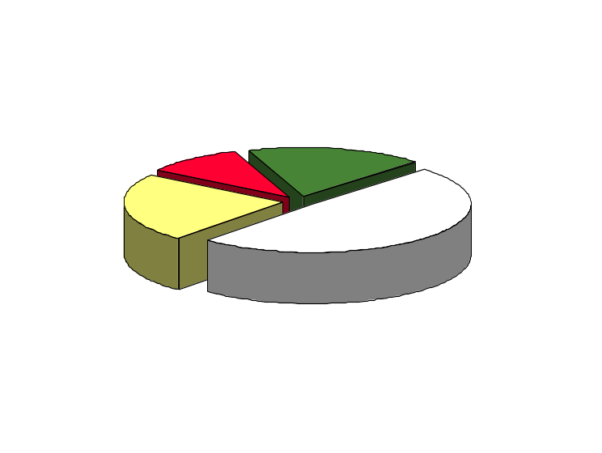
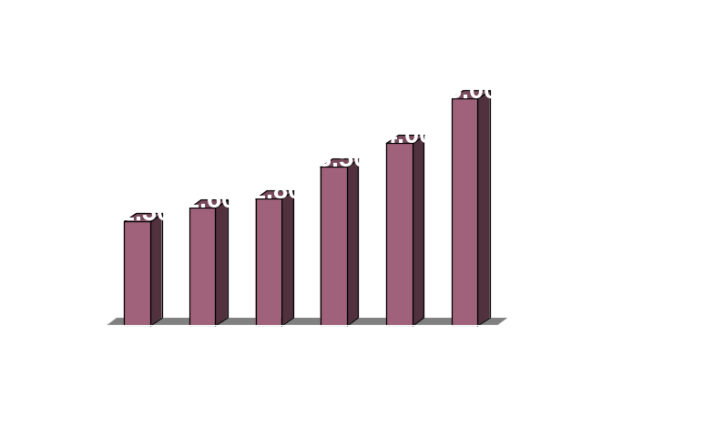
ETC Engineers Stability
ETC Engineers Corporate based in Little Rock, Arkansas
Environmental, Civil and Mechanical services to Govt., City and Municipalities
ETC Engineers has retained key skills with challenging work.
ETC Engineers is a company with more than 25 years of experience; projected 2009 revenues of $5 million; and over 125 employees in US and offshore
ETC Engineers is a growing, financially strong and diversified company with long-term, core customers.

Slide 7
ETC Engineers
Areas of Service for Govt. and Cities
Water Distribution and Treatment
Wastewater Collection and Treatment
Hydraulics and Hydrology
Environmental Engineering
Mechanical Engineering
Structural Engineering
Dam Design, Rehabilitation, Reservoir Control, Levees
Flood Control, Drainage and Computerized Stromwater Management Studies
Computer Modeling, Analysis and Simulation
Urban and Rural Roadway Design
Design/Build and construction
Canals and Irrigation Systems
Parks Planning and Design
Design of New Structures, Rehabilitation and Additions
Feasibility Studies
Construction Management, Inspection
Surveying
Air Quality Control
Underground Storage Tanks - Removal and Investigations
Environmental Permits and Audits
Public Swimming Pool Design, Modernization and Renovation

Slide 8
StarGroup
Partner Company Profile
Bangladesh

Slide 9
StarGroup
Offshore-based Software Development
Reduce SW Development Costs • Improve Customer Satisfaction • Build a Lucrative Business

Slide 10
StarGroup
Quality Software Development & Support
Founded in 1991, is a pioneer as an ICT solution provider.
ISO 9001:2000 certified company for software design, development, maintenance, sales.
    Primary objective is to help the leading companies to mobilize current IT infrastructure
Improve corporate performance by reducing costs
Increasing profitability through superior Software solutions.
  Core Competencies
  - Quick understanding and documenting business requirements in a way that facilitates solution design
  - Choosing tools that solve today's problems and anticipate tomorrow's needs
  - Establishing appropriate development processes and working with development organizations to adopt them
  - Managing large, low cost, off-site and on-shore development teams.

Slide 11
StarGroup
Quality Software Development & Support
What differ SCS from others?
- A unique set of corporate values
- Skilled, enthusiastic and experienced staff - Without compromise we maintain software development Processes
- Quality assurance systems
- Speedy project implementation
- High degree of confidentiality
SCS Software Development Team
- All of the IT professionals are graduated from the top national universities. Most of them hold MS/BS degree in technology and science.
- Number of engineering team members are certified by IT industry leaders such as Microsoft (MCSD, MCSE), Sun, Oracle (OCP) etc.
- MBA and PMI for managers
- Intensive skills and deep knowledge both in IT and Software technology and business areas. Team members are creative thinkers, comfortable with solving complex issues

Slide 12
StarGroup
Quality Software Development & Support
Quality Policy
SCS will always strive to be a customer centric organization that will reflect in all its internal procedures.
SCS will maintain a process of continuous improvement of its Quality Management System.
SCS will always strive for win-win relationships with its customers.
SCS will carry out adequate research and development in its chosen fields of activities so that its products and services are subject to a continuous process of innovation and improvement aimed at satisfying customers’ current and future needs.
SCS will make adequate financial and other investments in the development of high quality human resources.
SCS's management will strive to maintain a work environment where team spirit, collective leadership, creativity, innovation, continuous self-development, honesty, personal integrity and a willingness to compete with the most successful organizations in the world, are recognized as essential ingredients for success.

Slide 13
StarGroup
SW Services
OS Security & Directory Service
SCS Operating System Security and Directory Services consist of four core processes:
    Operating System Service
    Operating Systems Security service
    Directory Service
    Enterprise service
Network & System Management
SCS Network and System Management Services consist of following core processes:
    IT Operations Service
    IT Optimization service
    Network Service Management
    Workstation Support (24/7)
    Server Support (24/7)
    Network Support (24/7)
IT Security
SCS Information Technology Security Services consist of four core processes:
    IT Security Risk Assessment Service
    IT Security Infrastructure Service
    Defense Planning Service
    Managed Security Services

Slide 14
StarGroup
SW Services
Storage System Service
SCS Storage System Services consist of three core processes:
    Storage Management Service
    Storage Architecture Service
IT Support
SCS is the best technology company for everyone. At SCS, we focus on the technology needs of today's changing business environment. The more we know about you, the more return you'll see from your investment with us.
    Unlimited Phone Support
    Proactive PC Monitoring and Server Monitoring
    Network Management
Web Services
    Dynamic and static pages design and development for corporate and individual clients.
    Yearly Domain registration.
    Yearly hosting system for any required space with free email and other related facilities.
Others services
    2D/3D Modeling and Games, Computer Graphics
    Consulting, Implementation & IT Infrastructure
    Data Entry/ Data conversion
    Data Processing Systems
    Data Warehousing

Slide 15
StarGroup
SW Products
SCS Software:
  SBS - Star Business Suite
  SRP - Study Resource Planning
  IHMS - Integrated Hospital Management System
  ESM - Electronic Staff Management System (ESM)
  TSM - Task Management System
  IQMS – Intelligent Queuing Management System
  TelLedger – Telephone Call Monitoring System
  Star TAS.NET – Time and attendance solution
  Star Accounting. net - Accounting and Bookkeeping system
  POS - Point of Sales
  Star LMS – Library Management System
  Star Inventory and Product Management Solution
  Star Asset Management Solution
  Star Garments Solution

Slide 16
StarGroup
SW Solutions
Software Solution:
  Accounting & Financial Management Software
  Business Intelligence
  Customize Software Solution
  Education & Health Management System
  Gaming Software
  Embedded Systems
  Garments Textile Software and ERP
  Health Care Software
  HR and Payroll Software
  Inventory Control and Management
  MFI, Leasing and Insurance
  Point of Sales
  Mobile/Cell phone Applications
  System Programming
  Workflow Management
  Utility and Billing
  Security monitor and control system
Web Solution:
  E-Business Systems, E-Learning, E-Governance Applications
  Web Application and Web Content Management System
  Streaming Web Based Multimedia System
  Search Engine Optimization (SEO)

Slide 17
StarGroup
SW Tools and Technologies
Analysis and design
  Object Oriented Analysis and Design (OOAD), UML using Visio, Rational Rose, Smartdraw, MS Project
Operating System
  Microsoft Windows Server, Windows XP, Windows 9x, Linux, Windows Mobile 2003
Interface and Development
  Visual C#.net, Visual Basic 6/ .net, Java, C++, ADO.net, XML, ActiveX, COM/DCOM, VBA, PLSQL
Web Application
  ASP, ASP.net (Code behind VB.net/ C#), PHP, JSP, XML, JavaScript, VBscript, DHTML, HTML, Macromedia flash, DreamWeaver, Microsoft FrontPage
Database System
  Microsoft SQL Server, Oracle, Microsoft Access, MySQL, Pervasive SQL
Server Systems
  Microsoft Windows 2000 Server, Microsoft Windows Server.net (2003), Linux Server, IIS, Apache, DNS, Names, Microsoft Exchange Server, Microsoft ISA Server
Reporting
  Seagate Crystal Report, Active Reports
Graphics and Web Design
  Banner: Adobe Photoshop, Illustrator, Macromedia Fireworks
  Flash Intro/Animation: Macromedia Flash, Swift 3D, Flex, Swish
  Digital E-Book/Brochure: DNAML, Macromedia Flash, Adobe Photoshop, Illustrator
  Static Website: Adobe Photoshop, Illustrator, Dreamweaver, Firework, Macromedia Flash, Frontpage, JavaScript, Java Applet
  Flash Interactive Website: Macromedia Flash, Adobe Photoshop, Illustrator, Swift 3D, Swish, Flex, XML
  Others: Flyer, Billboard, Digital Sign
Deployment: Installshield Professional, Microsoft Installer

Slide 18
StarGroup
Offshore-based Data Entry Services
Reduce Support Costs • Improve Customer Satisfaction • Build a Lucrative Business

Slide 19
StarGroup
Data Entry Services
6000 Sq. Ft. Data Entry 100 terminals outfit
Runs 8 hours 2 shift 6 days a week
Experienced and skilled Data Entry operators
Educated operators; have Good verbal and written English communication skills
On going training to update skills for operators and management personnel
Work for non sensitive and non time critical work
21 Days or more turn around time
Mode of Data Shipping
  Make Photocopies and Ship hard copy to offshore
  Scan Original send image file to offshore
  Return original cards to the company as soon photocopy is done
Data will be entered and the product will ship back in CDs as per customer’s data format
Follow double entry system and Ensures 95+ percent accuracy
Use OCR Technology
In-house software development for Data Entry and Double Entry system
Very cost effective

Slide 20
StarGroup
Offshore-based Call Center Services
Reduce Support Costs • Improve Customer Satisfaction • Build a Lucrative Business

Slide 21


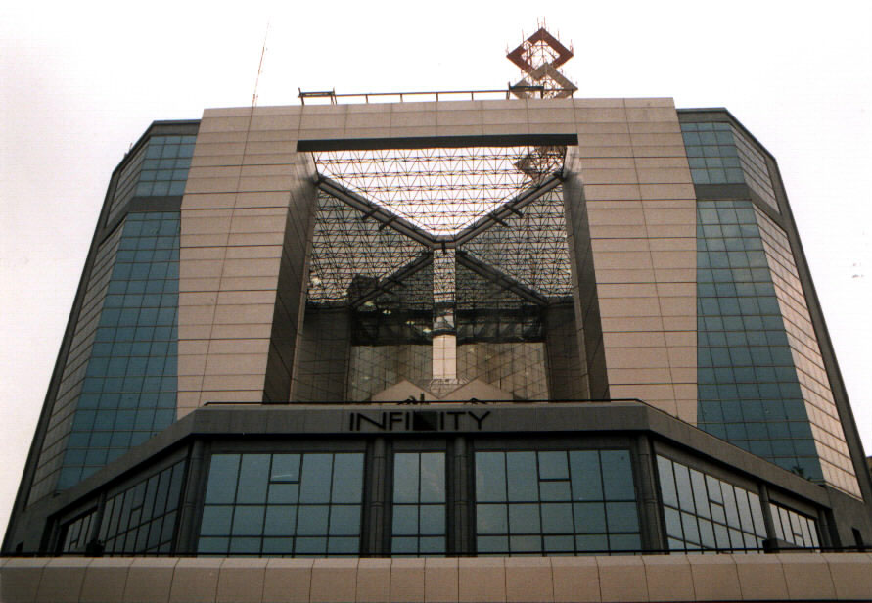

Call Center Application - Offshore Model
24*7*365 Global Coverage
Shift coverage
Bangladesh
USA
Asia
Americas
Bangladesh
Europe
Technical Support (Software Help Desk, DBA support)
Transactional Support (FAQ, Telemarketing, Back Office)
Incubation (Call Center, DBA support, remote monitoring)

Slide 22
StarGroup - Call Center Support
Approach
Superior support center performance is achieved by carefully managing four key components
People
Infrastructure
Process
Measurements

Slide 23
StarGroup - Call Center Support
Agents
College graduates and engineers
Fluent in English; courteous
Experienced business managers eliminate your transition and staffing issue concerns
High retention
Trained to be aware of United States culture
Average operator training goal is 15 days
24 x 7 x 365 availability
Technical skills available – Windows application support, Database support, ERP support

Slide 24
StarGroup - Call Center Support
Infrastructure
Global Communication Network
Asynchronous Transfer Mode (ATM) Migration Path
Shared & dedicated Ethernet connectivity
Advanced network management systems
Category 5 Gigabit per second Structured Cabling Systems Compliant with EIA-586A Standards
Nortel - Meridian 61 C PBX
Nortel - Passport 6480 Edge-Switch
Computer Telephony Integration (CTI) Links
Cincom Encompass CRM Servers
Client Service Architecture
Fault Tolerant Compaq NT Servers with disc array subsystems
Secure & fault tolerant Compaq servers
CTI (Computer Telephony Integration)
Versatility 3.2 based applications
Database
Fulfillment
Unified Messaging
Predictive Dialing

Slide 25
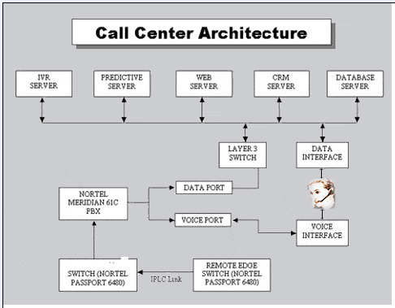
StarGroup - Call Center Support
Infrastructure
Fully Equipped Workstations & Servers
Intel high-end Pentium CPU-based Compaq Workstations
17” monitors for easy view of screen pop ups
Microsoft Windows NT/XP/Vista Operating Systems
Microsoft SQL Server, Oracle, Sybase RDBMS supported
Nortel Digital Telephone Sets
Plantronics Binaural/Noise Canceling Headsets
Individual cubicles for privacy

Slide 26
StarGroup - Call Center Support
Process
Design for Six Sigma methodology will be used to create robust processes that fulfill your specific customer needs.
  Define: The scope of the project and other operating parameters will be established
  Measure: The customers of the call center (end customers, business managers, etc.) and their needs will be quantified. A score-card will be generated for the Service Level Agreement (SLA)
  Analyze: The high level processes e.g. call routing, handling, escalation, training, recruiting, etc. will be created
  Design: The detailed design including human and technology design will be created. An FMEA analysis will be conducted
  Verify: A pilot will be performed for 4-6 months and validated against the score-card
  Institutionalize: This full production stage, will be an ongoing process of compliance, resource/SLA management, and reporting
Define
Measure
Analyze
Design
Verify
Production

Slide 27
StarGroup - Call Center Support
The Measurements
Example efficiency metrics:
  Abandonment Rates
  Number of Calls per Agent
  Average Speed of Answer
  Average Time of Each Call
  Percentage of Blocked Calls (Busy)
Example effectiveness metrics
  First contact completion and escalation ratios
  Personnel costs and head count distribution
  Agent rating of customer satisfaction
A joint team will periodically review these metrics
Any special reporting needs can be accommodated
We offer periodic trips to the call center for your auditing purposes
Define
Measure
Analyze
Design
Verify
Production

Slide 28
Summary
ElectroData
Discriminators
Excellence
Stability
Diversity
Cost/Schedule
Industry Experience
ElectroData and it’s Partner Companies are diverse and growing companies which are committed to excellence and customer satisfaction.
ElectroData and it’s Partner Companies Engineers relevant project management experience provides a unique edge in providing resources to business and industry and cost efficient solutions for wide range of engineering disciplines.
ElectroData and it’s Partner Companies are flexible and can easily adapt to changing work loading and contract requirements.
To contact us at ElectroData :
Colorado Office:
Rafiqul Islam / Chad Licky
2563 Xenia Street
Denver, Colorado 80238
Tel: (720) 270- 0081
Fax (303) 375-9166

